Slide 1
RESEARCH PROPOSAL
When Do We Really Need
Foundational Forecasting Models?
Assessing the feasibility of foundational forecasting models and analyzing when they're best utilized for the ease of access they provide in their implementation.
Notes:
investigates when Foundation Forecasting Models are actually needed
rather than focusing on a single dataset benchmarks multiple forecasting model families across several domains and dataset sizes to identify when Foundational Models are most effective.

Slide 2
Research Questions
Five guiding questions frame the investigation into foundational vs. traditional forecasting approaches.
Do foundational models outperform traditional models on small datasets?
1
At what dataset size do traditional models catch up?
2
How does performance vary across forecast horizons?
3
Which model type gives the best value?
4
Are foundational models less effective on fringe or highly domain-specific datasets?
5
Notes:
five research questions.
whether Foundation Models outperform traditional methods on small datasets.
whether there is a dataset scale at which traditional methods catch up or lose their advantage.
how forecasting horizon affects performance.
which model family provides the best balance between accuracy and practicality.
whether Foundation Models struggle on niche or domain-specific datasets.

Slide 3
Scope
The study spans multiple data types, sizes, and forecast horizons to stress-test model behavior.
1
Dataset Types
2
Dataset Size
Sales, demand, finance, and other real-world data domains
Small and medium scale variants of each dataset
3
Forecast Horizon
4
External Variables
Short, medium, and long range forecasting windows
Covariates layered in to test added contexts value
Notes:
To answer these questions, the benchmark spans multiple domains including agriculture, energy, retail, traffic, and forecasting competition datasets.
Each dataset was split into small and medium-scale variants.
Different forecast horizons were evaluated depending on dataset characteristics.
Where available, external covariates were incorporated to assess whether additional context changes model performance.

Slide 4
Models & Techniques
Four model families are benchmarked head-to-head under a shared evaluation pipeline.
Foundational
Classical
Machine Learning
Deep Learning
Amazon Chronos
TTM
ARIMA
SARIMA
LightGBM
XGBoost
N-HiTS
LSTM
Notes:
Four forecasting families were evaluated.
Foundation Models included Chronos and Tiny Time Mixer.
Classical Models included ARIMA and SARIMA.
Machine Learning Models consisted of LightGBM and XGBoost.
Deep Learning Models included LSTM and N-HiTS.

Slide 5
Evaluation Metrics
Accuracy
SMAPE, RMSE, and MAE across all forecast horizons
1
Runtime / Inference Time
Speed of generating forecasts at scale
2
Training / Tuning Effort
Human and process effort to get a model production-ready
3
Computation / Resource Cost
Hardware and infrastructure demands
4
Ease of Use
Implementation and maintenance overhead
5
Notes:
Models were evaluated using several metrics.
Accuracy was measured using SMAPE, RMSE, and MAE.
Runtime captured forecasting efficiency.
Resource and implementation costs were also considered.
Since forecasting systems are deployed in production environments, practical considerations such as computational cost and ease of implementation are just as important as pure predictive accuracy.

Slide 6
Working Assumptions
Hypotheses the benchmarking results will confirm, refine, or challenge.
“
Foundational models offer higher value on smaller datasets thanks to pretraining, but that edge tapers off as traditional models catch up with more data.
“
Fringe or highly domain-specific datasets get much less value from pretrained foundational models than general datasets do.
“
Raw accuracy is not the primary determinant of feasibility — cost, effort, and ease of use matter too.
“
Forecast horizon is a key factor in deciding which model family is the right fit.
Notes:
Before beginning the study, several assumptions were made.
The first assumption was that Foundation Models would be most useful on smaller datasets because they benefit from pretraining.
Another assumption was that domain-specific datasets might reduce the effectiveness of pretrained representations.
I also assumed that forecast horizon would strongly influence which model family performs best.
The benchmark results were then used to validate or challenge these assumptions.

Slide 7
Data pipeline
1
Raw dataset
2
Standardization
3
Data cleaning
6
Evaluation
5
Forecasting
4
Train/test split
Notes:
Raw datasets were first standardized into a consistent format.
Data cleaning was then performed.
Time-based train-test splits were created.
Forecasts were generated by each model family.
evaluated using common benchmark metrics.

Slide 8
Key Activities
Setup & Data Preparation
Finalize research scope and hypotheses
Download and validate all datasets
Perform EDA on each dataset
Create small, medium, and large dataset variants
Build common benchmarking pipeline
Define forecast horizons and evaluation metrics
Notes:
The first phase of the project focused on data preparation.
Datasets were collected and validated.
Exploratory analysis was performed to understand dataset characteristics.
Common preprocessing procedures were developed.
Dataset variants and forecast horizons were defined before model experimentation began.

Slide 9
Key Activities
Model Benchmarking
Run classical models (ARIMA, SARIMA, Naive, SNaive)
Run ML models (XGBoost, LightGBM)
Run deep learning models (LSTM, N-HITS)
Run foundational models (Chronos, TTM)
Collect accuracy, runtime, and resource metrics
Consolidate results into a master benchmark notebook
Notes:
The second phase focused on experimentation.
Every model family was trained and evaluated using the same benchmark setup.
Accuracy, runtime, and resource metrics were collected and consolidated into a master benchmark table.
This created a unified environment for comparing fundamentally different forecasting approaches.

Slide 10
Problems
Limited computing power
Limited practical covariate data
Conflicting library support systems
Standardization for comparison
Notes:
Several challenges were encountered throughout the project.
The first was dataset standardization because datasets differed significantly in structure, frequency, and scale.
Computational limitations also became important, particularly for Foundation Models such as Chronos, which required significantly longer runtimes.
Dependency management created additional challenges due to conflicting package requirements.
Finally, covariate availability varied considerably between datasets, making fair comparisons more difficult.

Slide 11
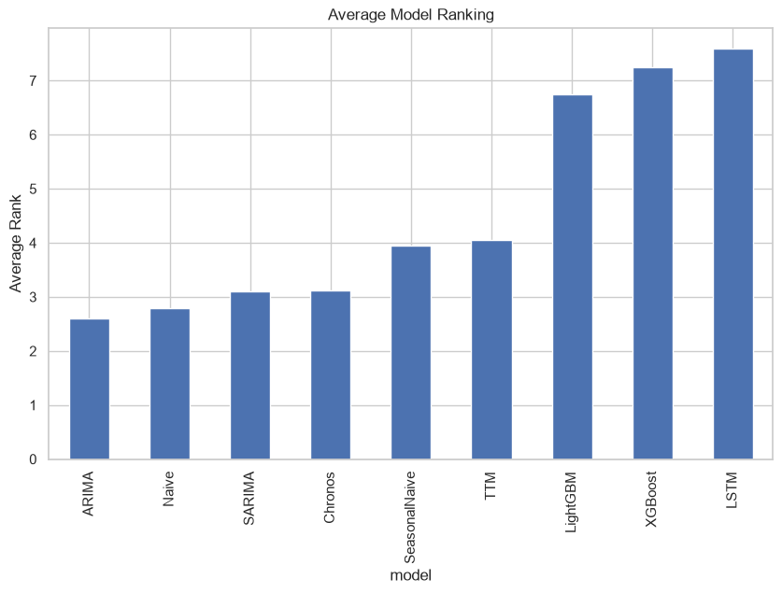
Model rankings
Notes:
Looking at overall rankings, Classical Models remained extremely competitive.
Foundation Models ranked close to the top while maintaining strong performance across many domains.
Machine Learning generally trailed behind Foundation and Classical approaches.
Deep Learning exhibited the weakest overall benchmark performance.

Slide 12
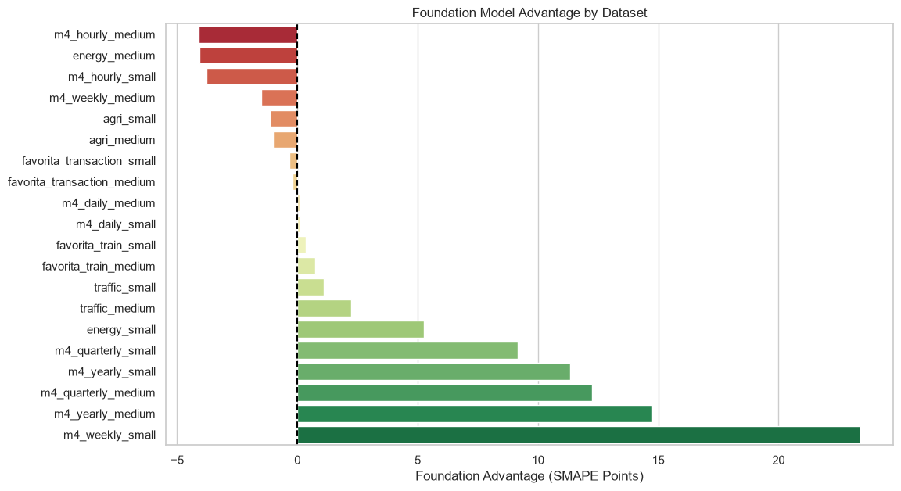
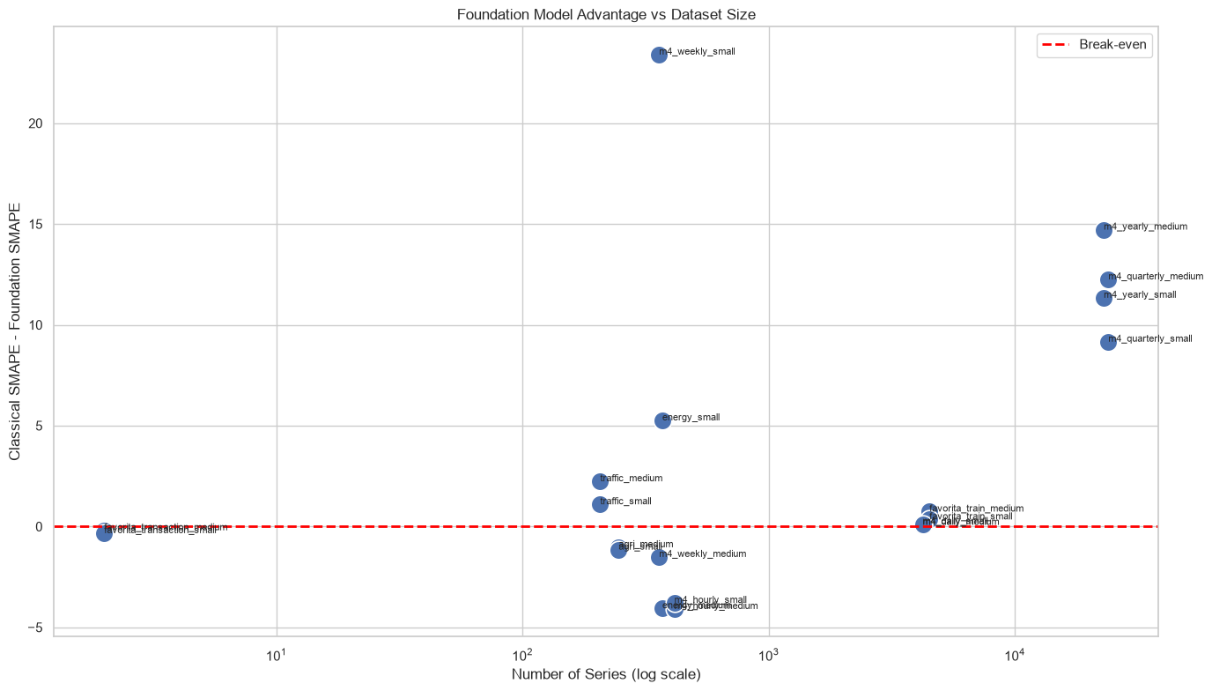
Baseline comparison
Δ_{F,C} = SMAPE_{Classical} − SMAPE_{Foundation}
9
Notes:
This graph directly addresses the research question.
The metric shown is Foundation Advantage, calculated as Classical SMAPE minus Foundation SMAPE.
Values above zero indicate a Foundation Model advantage.
Values below zero indicate a Classical Model advantage.
Agriculture datasets favored Classical methods.
The largest retail datasets consistently favored Foundation Models.
M4 Quarterly and M4 Yearly also showed substantial Foundation Model advantages.
This suggests that Foundation Models become increasingly effective on large-scale and complex forecasting tasks.

Slide 13
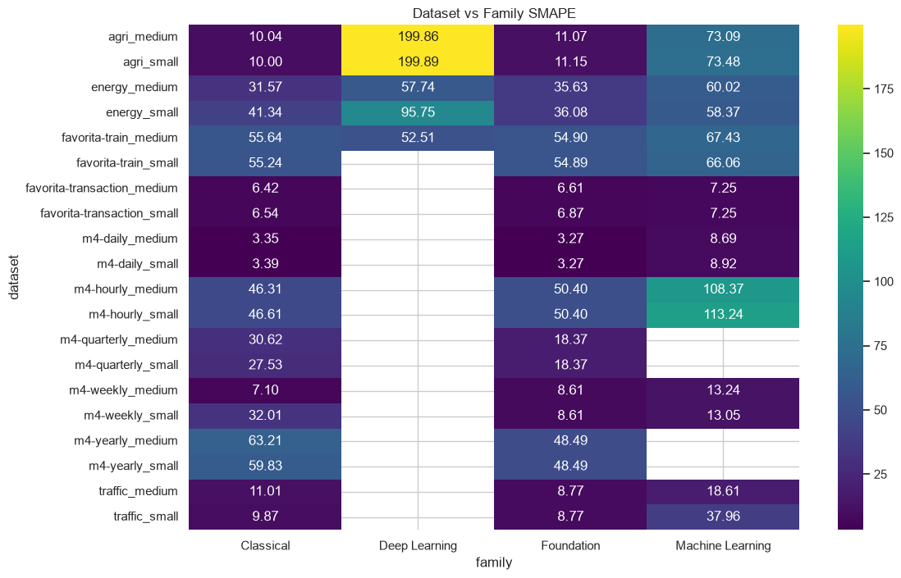
Comparison heatmap
Notes:
Foundation Models achieved the lowest error on the majority of benchmark datasets.
They performed particularly well on Traffic, M4 Quarterly, M4 Yearly, and Favorita Retail datasets.
Classical models remained strongest on Agriculture datasets and some shorter-frequency forecasting tasks.
The most important conclusion is that no model family dominated every benchmark.
Implying that foundational models aren't an end all solution to all dataset problems

Slide 14
Benchmark
Number of observations | < 50,000 | 50,000 – 250,000 | 250,000 – 1,000,000 | 1,000,000 – 5,000,000
<500 series | Traditional models | Traditional models | Foundational viable | Foundational Preferred
500 – 2000 series | Traditional models | Both viable | Foundational Preferred | Foundational Preferred
2000 – 5000 series | Both viable | Foundational Preferred | Foundational Preferred | Foundational Preferred
> 5000 series | Foundational viable | Foundational Preferred | Foundational Preferred | Foundational Strongly Preferred
Notes:
Based on the benchmark findings, a practical decision framework was developed.
For datasets containing fewer than 500 series and fewer than 50,000 observations, Classical methods are generally preferable.
As scale increases, Foundation Models become increasingly attractive.
Datasets containing several thousand series and hundreds of thousands of observations consistently favored Foundation approaches in this benchmark.
This framework provides guidance for selecting forecasting architectures based on dataset characteristics.

Slide 15
Thank You
Notes:
When do we really need Foundation Forecasting Models?
The answer is that Foundation Models are not universal replacements for Classical forecasting methods.
Classical models remain extremely competitive for smaller and more structured forecasting problems.
However, Foundation Models demonstrated the strongest overall cross-domain generalization and achieved the best performance on most large-scale benchmarks.
Deep Learning models provided the weakest cost-to-performance tradeoff within this study.
The key takeaway is that Foundation Models become increasingly valuable as forecasting problems grow in scale and complexity.

